Slide 1
8255 PPI
PPI
Programmable Peripheral Interface

Slide 2
Intel 8255 PPI
PPI – Programmable Peripheral Interface It is an I/O port chip used for interfacing I/O devices with microprocessor Very commonly used peripheral chip Knowledge of 8255 essential for students in the Microprocessors lab for Interfacing experiments

Slide 3
About 82C55
The 82C55 is a popular interfacing component, that can interface any TTL-compatible I/O device to a microprocessor.
It is used to interface to the keyboard and a parallel printer port in PCs (usually as part of an integrated chipset).
Requires insertion of wait states if used with a microprocessor using higher that an 8 MHz clock.
PPI has 24 pins for I/O that are programmable in groups of 12 pins and has three distinct modes of operation.

Slide 4
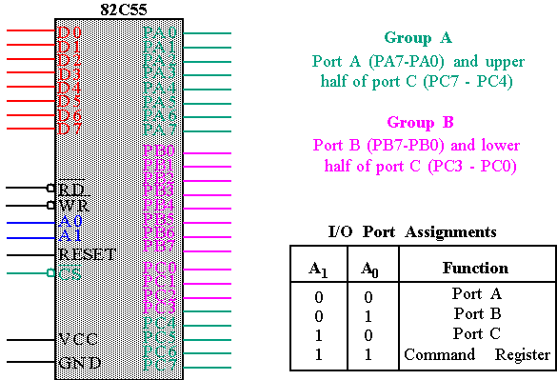
82C55 : Pin Layout

Slide 5
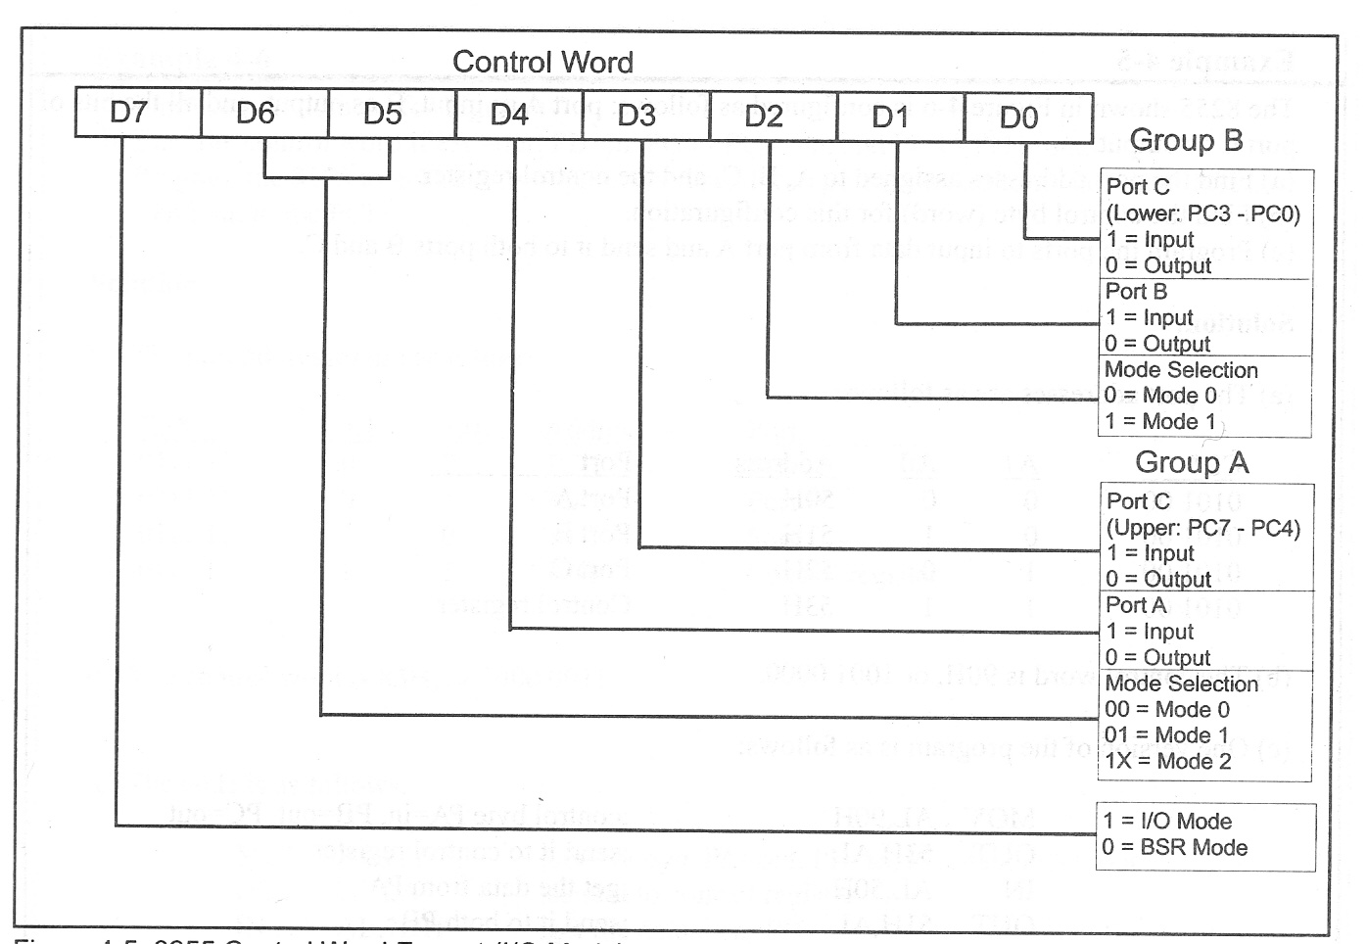
8255 Control Word

Slide 6
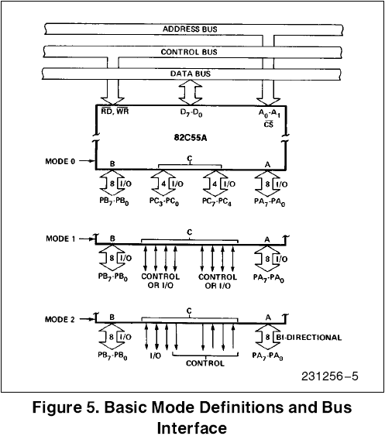
Basic Mode Definitions and Bus Int
Mode 0
  Basic I/O
Mode 1
  Strobe I/O
Mode 2
  Bi-Dir Bus

Slide 7
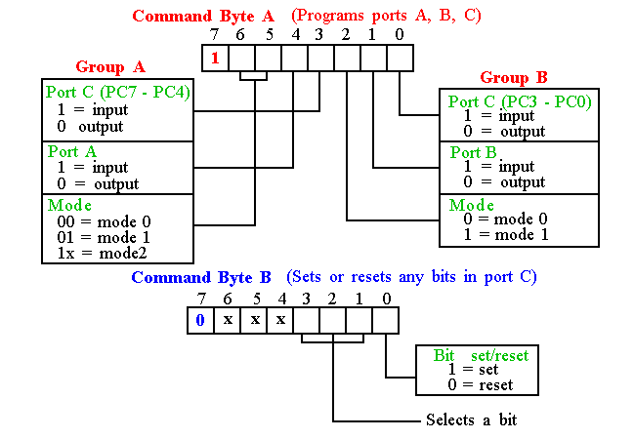
Programming 8255
8255 has three operation modes: mode 0, mode 1, and mode 2
11-<number>

Slide 8
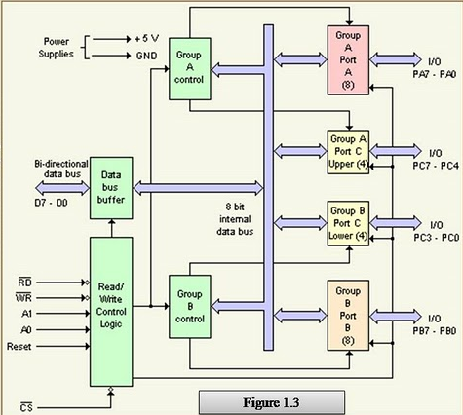

Slide 9
8255 PPI contd.
3 ports in 8255 from user’s point of view - Port A, Port B and Port C. Port C composed of two independent 4-bit ports - PC7-4 (PC Upper) and PC3-0 (PC Lower)
A1 | A0 | Selected port
0 | 0 | Port A
0 | 1 | Port B
1 | 0 | Port C
1 | 1 | Control port

Slide 10
8255 PPI Contd.
There is also a Control port from the Processor point of view. Its contents decides the working of 8255. When CS (Chip select) is 0, 8255 is selected for communication by the processor. The chip select circuit connected to the CS pin assigns addresses to the ports of 8255. For the chip select circuit shown, the chip is selected when A7=0, A6=1, A5=1, A4=1, A3=1, A2=1, & M/IO*= 0 Port A, Port B, Port C and Control port will have the addresses as 7CH, 7DH, 7EH, and 7FH respectively.

Slide 11
8255 PPI Contd.
Mode 0: Simple Input or Output
In this mode, ports A, B are used as two simple 8-bit I/O ports
port C as two 4-bit ports.
Each port can be programmed to function as simply an input port or an output port. The input/output features in Mode 0 are as follows.
1. Outputs are latched.
2. Inputs are not latched.
3. Ports don’t have handshake or interrupt capability.

Slide 12
8255 PPI Contd.
Mode 1: Input or Output with Handshake
In this mode, handshake signals are exchanged between
the MPU and peripherals prior to data transfer.
The features of the mode include the following:
1. Two ports (A and B) function as 8-bit I/O ports.
They can be configured as either as input or output ports.
2. Each port uses three lines from ort C as handshake signals.
The remaining two lines of Port C can be used for simple I/O operations.
3. Input and Output data are latched.
4. Interrupt logic is supported.

Slide 13
8255 PPI Contd.
Mode 2: Bidirectional Data Transfer
This mode is used primarily in applications such as data transfer
between two computers.
In this mode, Port A can be configured as the bidirectional port
Port B either in Mode 0 or Mode 1.
Port A uses five signals from Port C
as handshake signals for data transfer.
The remaining three signals from port C can be used either
as simple I/O or as handshake for port B.

Slide 14
8255 Handshake signals
Where are the Handshake signals? Port C pins act as handshake signals, when Port A and Port B are configured for other than Mode 0. Port A in Mode 2 and Port B in Mode 1 is possible, as it needs only 5+3 = 8 handshake signals After Reset of 8255, Port A , Port B , and Port C are configured for Mode 0 operation as input ports.

Slide 15
8255 Handshake signals Contd.
PC2-0 are used as handshake signals by Port B when configured in Mode 1. This is immaterial whether Port B is configured as i/p or o/p port. PC5-3 are used as handshake signals by Port A when configured as i/p port in Mode 1. PC7,6,3 are used as handshake signals by Port A when configured as o/p port in Mode 1. PC7-3 are used as handshake signals by Port A when configured in Mode 2.

Slide 16
8255 PPI Contd.
Port A can work in Mode 0, Mode 1, or Mode 2 Port B can work in Mode 0, or Mode 1 Port C can work in Mode 0 only, if at all Port A, Port B and Port C can work in Mode 0 Port A and Port B can work in Mode 1 Only Port A can work in Mode 2

Slide 17
8255 MD Control word
Control port having Mode Definition (MD) control word
1 | M2A |  | M1A |  | I/P A | I/P C_{U} |  | M1B | I/P B | I/P C_{L}
Means Mode Definition control word |  |  |  | 1 - PC_{U} as input 0 - PC_{U} as output 1 - PA as input 0 - PA as output |  |  |  | 1 -PC_{L} as input 0 -PC_{L} as output 1 - PB as input 0 - PB as output 1 – Port B in Mode 1 0 – Port B in Mode 0
M2A M1A
0 0 |  | Port A in Mode 0
0 1 |  | Port A in Mode 1
1 0/1 |  | Port A in Mode 2

Slide 18
8255 MD Control word Contd.
Ex. 1: Configure Port A as i/p in Mode 0, Port B as o/p in mode 0, Port C (Lower) as o/p and Port C (Upper) as i/p ports.
Required MD control word:
 |  | 1 | 0 | 0 | 1 | 1 | 0 | 0 | 0 | = |  | 98H
MD control |  |  |  |  |  |  |  |  | PC Lower as o/p
 | PA in Mode 0 |  |  |  |  |  |  | PB as o/p Reqd. instrns.
 |  | PA as i/p |  |  |  |  | PB in Mode 0 |  |  |  | MOV AL, 98H
 |  |  |  |  |  | PC Upper as i/p |  |  |  |  | OUT 7FH, AL

Slide 19
8255 MD Control word Contd.
Ex. 2: Configure Port A as i/p in Mode 1, Port B as o/p in mode 1, Port C7-8 as i/p ports. (PC5-0 are handshake lines, some i/p lines and others o/p. So they are shown as X)
Required MD control word:
 |  | 1 | 0 |  | 1 | 1 | 1 | 1 | 0 | X | = |  | BCH or BDH
MD control |  |  |  |  |  |  |  |  |  | PC3-0 as don’t care
 | PA in Mode 1 |  |  |  |  |  |  |  | PB as o/p Reqd. Instrns.
 |  | PA as i/p |  |  |  |  |  | PB in Mode 1 |  |  |  | MOV AL,BCH
 |  |  |  |  |  | PC Upper(C7-8) as i/p |  |  |  |  |  | OUT 7FH, AL

Slide 20
8255 Contd.
There are 2 control words in 8255 Mode Definition (MD) Control word and Port C Bit Set / Reset (PCBSR) Control Word MD control word configures the ports of 8255 - as i/p or o/p in Mode 0, 1, or 2 PCBSR control word is used to set to 1 or reset to 0 any one selected bit of Port C

Slide 21
8255 MD Control word Contd.
Ex. 3:Configure Port A in Mode 2, Port B as o/p in mode 1. (PC5-0 are handshake lines for Port A and PC2-0 are handshake signals for port B)
Required MD control word:
 |  | 1 | 1 | 0 | X | X | 1 | 0 | X | = |  | C4H / C5H..
MD control |  |  |  |  |  |  |  |  | PC3-0 as handshake
 | PA in Mode 2 |  |  |  |  |  |  | PB as o/p Reqd. instrns.
 | PA bidirectional |  |  |  |  |  | PB in Mode 1 |  |  |  | MOV AL, C4H
 |  |  |  | PC7-0 as handshake |  |  |  |  |  |  | OUT 7FH, AL

